Slide 1

Human-autonomy teaming guidelines with spacesuit example
Mike Matessa
Jake Rohrig
Collins Aerospace

Slide 2
Human-Autonomy Teaming
Defining “autonomy” can be controversial
We are using NASA’s concept of autonomy as “increasingly autonomous systems”
This covers systems from today’s Flight Management Systems to future advanced autonomy
This lets us start addressing current systems with an eye to future systems

Slide 3
Different HAT Factors
NASA/NATO
Communication
Functional Division
Shared Understanding
Decision Making
Learning
Trust
Performance
NASA HAT Lab
Operator-directed
Bi-directional communication
Transparency
MITRE
Transparency
Observability
Predictability
Augmented Cognition
Directing Attention
Exploring Solution Space
Adaptability
Coordination
Directability
Calibrated Trust
Common Ground
NOTECHS CRM
Cooperation
Management
SA
Decision Making
LOSA CRM
Planning
Execution
Review
Overall
Notes:
Draper, M. & Neerincx, M. (2020). Human-Autonomy Teaming: Supporting Dynamically Adjustable Collaboration. TR-HFM-247. DOI 10.14339/STO-TR-HFM-247.
McDermott, P., Dominguez, C., Kasdaglis, N., Ryan, M., Trhan, I., & Nelson, A. (2018). Human-machine teaming systems engineering guide. MITRE CORP BEDFORD MA BEDFORD United States.

Slide 4
Human Teaming Evaluation: NOTECHS
Category | Element | Behavior
Cooperation | Considering others | Consider condition of other
 | Supporting others | Offer assistance
Management/ Leadership | Authority/Assertiveness | Take Initiative
 | Maintain standards | Enforce SOP
 | Planning/Co-ordinating | State plan
 | Workload management | Distribute tasks
Situation Awareness | System awareness | Monitor/report system (incl. other crew)
 | Env awareness | Monitor/report env
 | Awareness of time (anticipation) | Monitor/report time constraints
Decision Making | Problem diagnosis | ID problem
 | Option generation | Generate/elicit options
 | Option selection | Select option
 | Outcome review | Review outcome
Notes:
Matessa, M. (2018). Using a crew resource management framework to develop human-autonomy teaming measures. In Advances in Neuroergonomics and Cognitive Engineering: Proceedings of the AHFE 2017 International Conference on Neuroergonomics and Cognitive Engineering, July 17–21, 2017.

Slide 5


Framework
Cooperation
Management
Situation Awareness
Decision Making
Performance
Trust
Transparency
Bi-directional Communication

Slide 6
Framework
Cooperation
“No info dumping”
Management
“Human-directed”
Situation Awareness
“Trends, not surprises”
Decision Making
“Collaborative solutions”
Performance
Trust
Transparency
Bi-directional Communication

Slide 7
General Guidelines
Cooperation
Consider workload of operator (adapt modality or wait)
Management
Allow easy re-tasking
Use operator-directed playbook
Situation Awareness
Use trends to give suggestions that avoid incidents
Acknowledge for mutual SA
Display time to future event
Display current goal and next step (given by playbook)
Decision Making
Provide options to operator, accept new options from operator
Allow easy changing of assumptions/priorities
Communication
Use bi-directional communication
Use common language (map instead of lat/long)

Slide 8
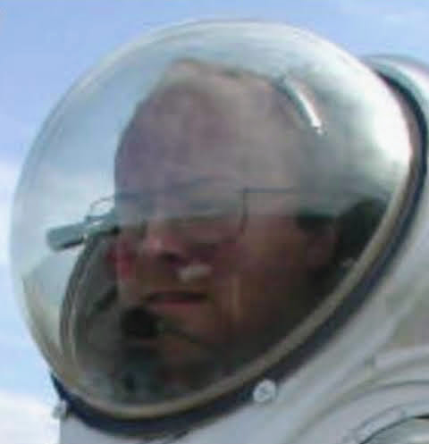
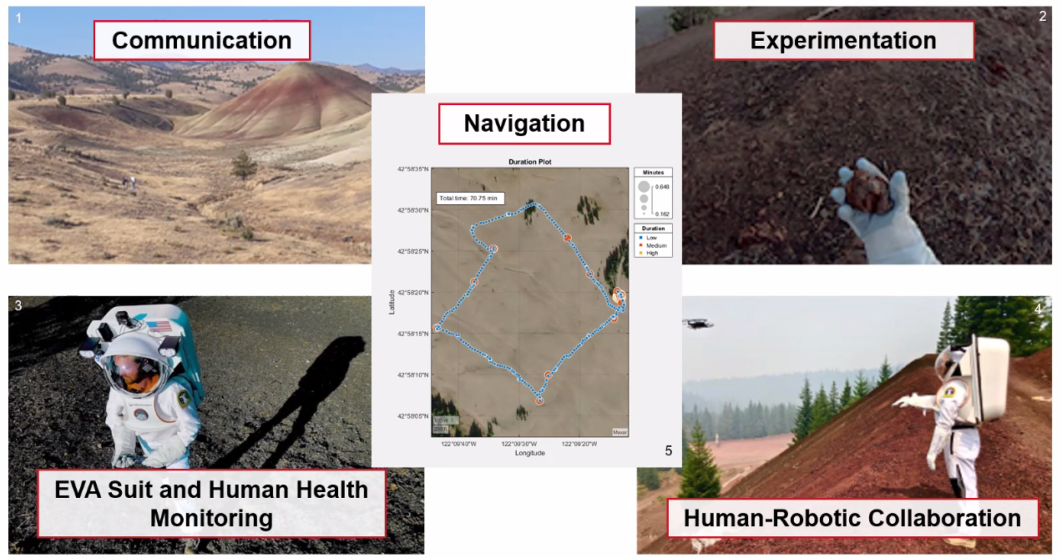
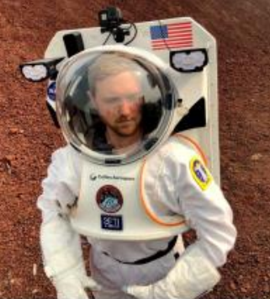
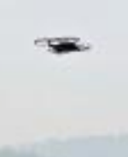
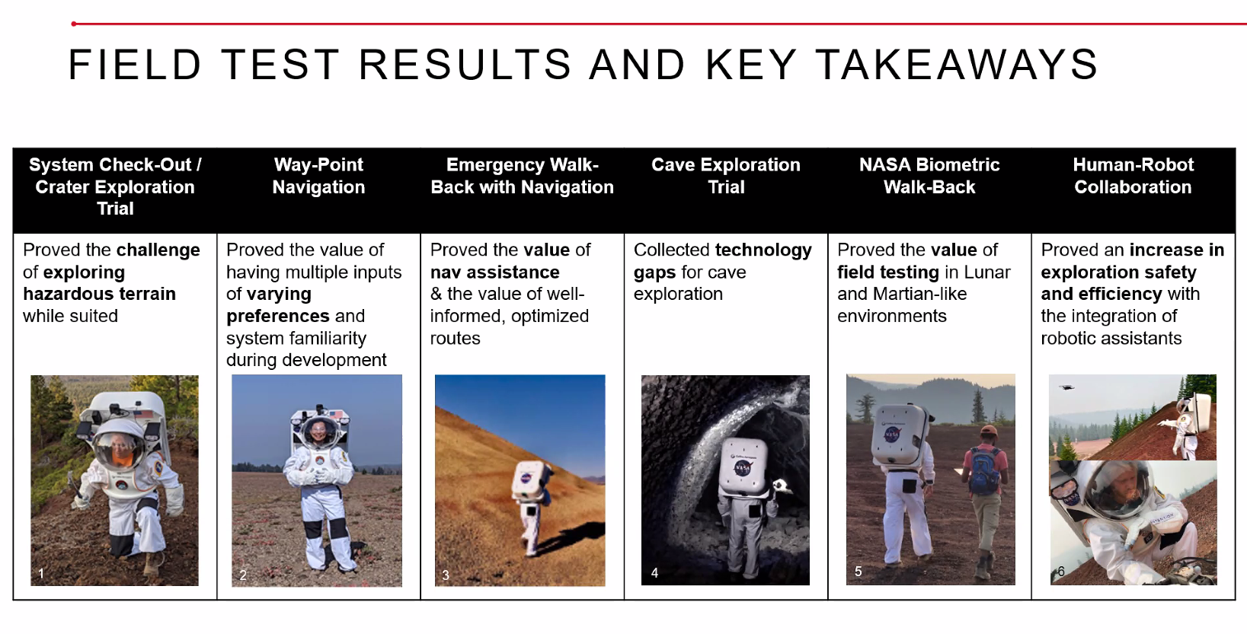
Spacesuit Assistant Functionality
Communication
Navigation
Health Monitoring
Collaboration
Exploration
Spacesuit functionality tested at the 2021 Haughton Mars Project field campaign
Notes:
Observation = monitoring of human/suit health
Rohrig, J., Himmelmann, A., Torralba, M., Quinn, G., et al. (2022). Development and Test of a Spacesuit Informatics System for Moon, Mars, and Further Deep-Space Exploration. 51st International Conference on Environmental Systems ICES-2022-66, 10-14 July 2022, St. Paul, Minnesota.

Slide 9
Spacesuit Assistant Results
Communication
Navigation
Health Monitoring
Collaboration
Exploration
Communication
Situation Awareness
Readback function of NLI commands improved user confidence through bi-directional communication and acknowledgement of mutual situation awareness
Decision Making
Management
Situation Awareness
Suit wearers were unable to alter waypoints as obstacles were encountered, highlighting importance of HAT guideline application
Situation Awareness
Cooperation
Health monitoring functions minimized likelihood of running out of battery during field trials; could improve cooperation by considering workload for information modality
Cooperation
Management
Programmed commands (operator-directed playbook) delivered to the drone reduced the effort required to pilot the drone
Management
Situation Awareness
It was determined that there should be means of controlling the suit lights and informing of suit proximity to collision hazards
Notes:
Observation = monitoring of human/suit health
Rohrig, J., Himmelmann, A., Torralba, M., Quinn, G., et al. (2022). Development and Test of a Spacesuit Informatics System for Moon, Mars, and Further Deep-Space Exploration. 51st International Conference on Environmental Systems ICES-2022-66, 10-14 July 2022, St. Paul, Minnesota.

Slide 10
General Guidelines
Cooperation
Consider workload of operator (adapt modality or wait)
Management
Allow easy re-tasking
Use operator-directed playbook
Situation Awareness
Use trends to give suggestions that avoid incidents
Acknowledge for mutual SA
Display time to future event
Display current goal and next step (given by playbook)
Decision Making
Provide options to operator, accept new options from operator
Allow easy changing of assumptions/priorities
Communication
Use bi-directional communication
Use common language (map instead of lat/long)

Slide 11
General Guidelines Spacesuit Guidelines
Cooperation
Consider workload of operator (adapt modality or wait) Use audio during physical exertion
Management
Allow easy re-tasking Allow wearer to control lights
Use operator-directed playbook
Situation Awareness
Use trends to give suggestions that avoid incidents Provide distance to cave walls
Acknowledge for mutual SA Give readback of speech recognition
Display time to future event Give info relative to full mission
Display current goal and next step (given by playbook)
Decision Making
Provide options to operator, accept new options from operator Allow wearer to alter waypoints
Allow easy changing of assumptions/priorities
Communication
Use bi-directional communication Allow wearer to alter waypoints
Use common language (map instead of lat/long)
Notes:
Rohrig, J., Himmelmann, A., Torralba, M., Quinn, G., et al. (2022). Development and Test of a Spacesuit Informatics System for Moon, Mars, and Further Deep-Space Exploration. 51st International Conference on Environmental Systems ICES-2022-66, 10-14 July 2022, St. Paul, Minnesota.

Slide 12
Conclusions
A framework used for evaluating human teaming is useful in human-autonomy teaming
Provides general guidelines
Can be used to develop specific guidelines
Enough fluff – Does the phrase “human-autonomy teaming” anthropomorphize systems?
Hopefully this is mitigated by
the use of the term “increasingly autonomous systems”
defining teaming functionality with a framework and specific guidelines
Future research is needed
on specific HAT guidelines for particular systems
to demonstrate effectiveness of implemented HAT guidelines
Notes:
Kaliardos, W. N. (2022, September). Enough Fluff: Returning to Meaningful Perspectives on Automation. In 2022 IEEE/AIAA 41st Digital Avionics Systems Conference (DASC) (pp. 1-9). IEEE.

Slide 13

Questions?

